Slide 1
APOD Viewer
A desktop application which shows Astronomy Picture of the day.
Prepared by: Gajendra Singh Thakur
Enrollment: 0176CS191064

Slide 2
Tech Stacks Used
Python
Python Libraries like: Web-browser, Requests, FileDialog
NASA API
Tkinter
PIL

Slide 3
Functionalities
Date Changing
View Photo & Description
Full Size Photo
Save Photo
Exit

Slide 4
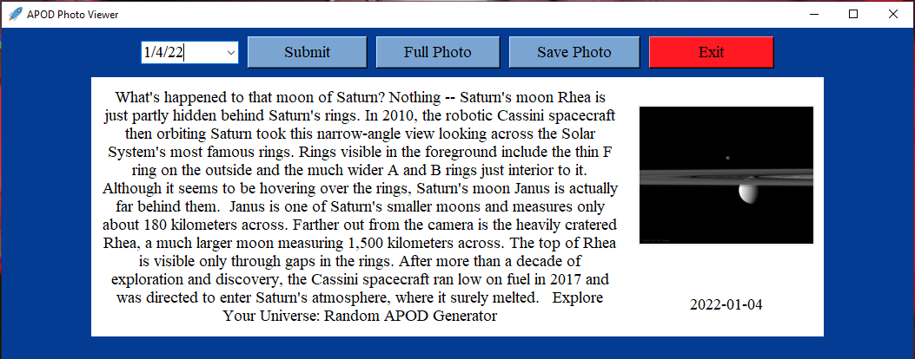
Snapshot of APOD Viewer

